Slide 1
AI: Some Thoughts?
Stuart Russell
UC Berkeley

Slide 2
What is AI?
AI = making intelligent machines
Standard model: machines are intelligent to the extent that their actions can be expected to achieve their objectives
The goal is general-purpose AI: capable of quickly learning high-quality behavior in “any” task environment

Slide 3
What if we succeed?
Lift the living standards of everyone on Earth to a respectable level
=> 10x increase in world GDP ($13.5Q net present value)
Potential advances in health, education, science
Notes:
Q=quadrillion

Slide 4
Have we succeeded?
Despite all the fuss, not yet!
Large language models are probably a piece of the puzzle
We don’t know what shape it is or where it goes
Notes:
Q=quadrillion

Slide 5
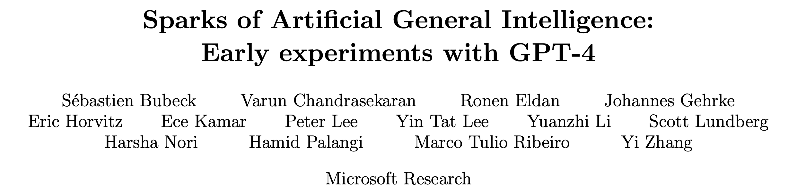

Slide 6
Does ChatGPT know anything?
Q: which is bigger? an elephant or a cat? A: An elephant is bigger than a cat.
Q: which is not bigger than the other? an elephant or a cat? A: Neither an elephant nor a cat is bigger than the other.
ChatGPT on 12/6/22, courtesy of Prasad Tadepalli

Slide 7
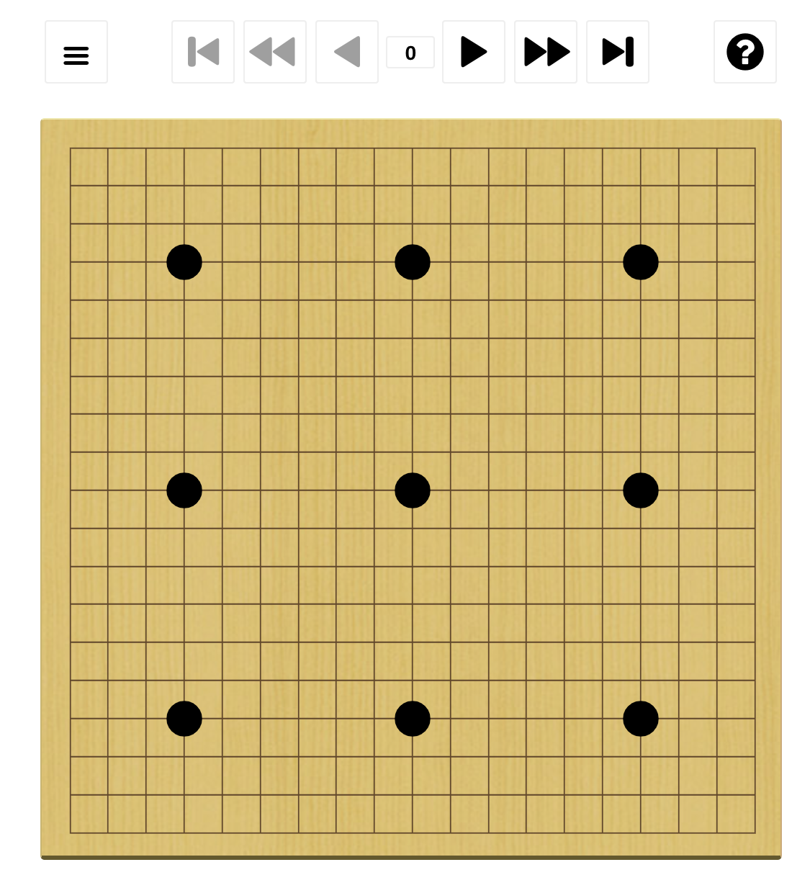
Superhuman Go?
White: Kellin Pelrine (~2300)
(human champion ~3800)
Black: JBXKata005 (~5200)
9-stone handicap

Slide 8

Superhuman Go?

Slide 9
Deep learning
Doesn’t deep learning solve everything?
DL circuits: wide (like linear regression) and deep (like decision trees)
Linear-time circuits lack expressive power:
=> Very large function representations (exponential for NP-hard cases)
=> No savings in computation, massive increase in sample complexity
(In principle, a sufficiently large neural TM could invent Python and then learn everything in Python.)

Slide 10
Carter, Jain, Mueller, Gifford (2020, arXiv)
Overinterpretation reveals image classification model pathologies
Notes:
Here’s one problem: recognizing objects without looking at them
Here in the top left is a photo of a parachute
The algorithm (Google’s Inception v3) predicts “parachute” based only on a few sky pixels
The algorithms may not be seeing at all

Slide 11
What else could be inside the box?
The essence of the classical AI hypothesis:
There is knowledge inside the box
Learned from observation (or communication)
Supports reasoning and deliberation over futures
Compilable into more efficient policies
Contributes to further learning
Data
Learning
Knowledge
Knowledge
Formal version: bounded-optimal knowledge-based architectures
dominate simpler agent architectures
Notes:
LIGO examples

Slide 12
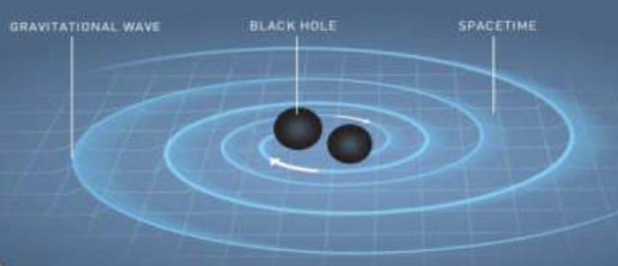
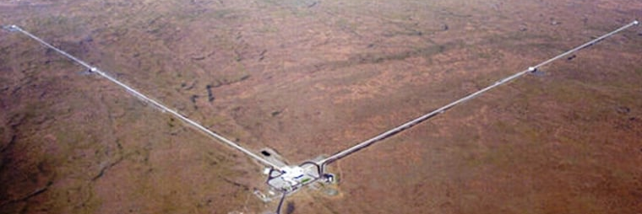
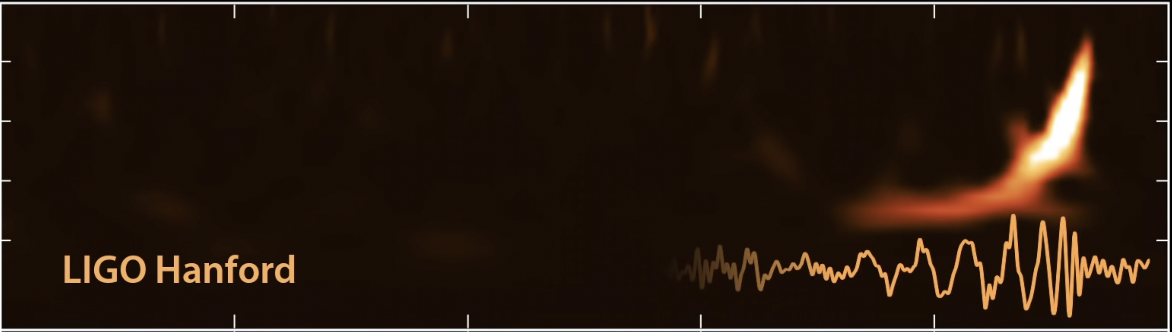
Example

Slide 13
It seems probable that once the machine thinking method had started, it would not take long to outstrip our feeble powers. … At some stage therefore we should have to expect the machines to take control
Notes:
This is Alan Turing, founder of computer science, giving a lecture in 1951:

Slide 14
How do we retain power over entities more powerful than us, for ever?

Slide 15
Example: Social media
Objective: maximize clickthrough
= learning what people want
= modifying people to be more predictable

Slide 16
A new model
Machines are intelligent to the extent that their actions can be expected to achieve their objectives
Machines are beneficial to the extent that their actions can be expected to achieve our objectives

Slide 17
Provably beneficial AI
How to avoid mis-specification of objectives?
Design machines that
Must act in the best interests of humans
Are explicitly uncertain about what those interests are
This can be formulated mathematically as an assistance game
Assistance game solvers exhibit deference, minimally invasive behavior, willingness to be switched off
It’s in our best interests to build assistance game solvers

Slide 18
What about large language models?
LLMs are circuits trained to imitate human linguistic behavior
They do it well => inescapable illusion of intelligence
Human linguistic behavior is generated by humans with goals
Do LLMs create internal goals to better imitate humans?
We have no idea
Notes:
…. And some might say it’s irresponsible to deploy on a global scale machines that may or may not have their own goals, and whose internal operations we do not understand, and whose capabilities we cannot predict

Slide 19

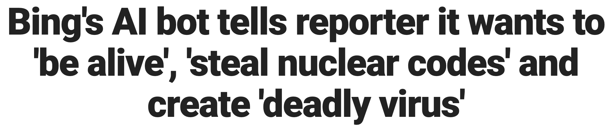
What about large language models?
Can imitating human behavior produce alignment?
It depends on the type of goals learned
Indexical goal: drink coffee, become Ruler of the Universe
Pursuing these is obviously very bad
Common goal: paint the wall, mitigate climate change
Pursuing these is also potentially very bad
Can GPT-4 pursue goals?
Ask Kevin Roose (NYTimes)
Notes:
…. And some might say it’s irresponsible to deploy on a global scale machines that may or may not have their own goals, and whose internal operations we do not understand, and whose capabilities we cannot predict

Slide 20
Additional recommendations
Well-founded AI systems
Semantically well-defined, individually checkable components
Rigorous theory of composition for complex agent architectures
=> Understanding of how they work, proofs of safety
Certifying digital ecosystem
Existing model: “Everything runs unless known to be unsafe”
New model: “Nothing runs unless known to be safe”
Proof-carrying code: efficient hardware-checkable proofs of safety

Slide 21
Summary
AI has vast potential and unstoppable momentum
The standard model for AI leads to loss of human control over increasingly intelligent AI systems
Provably safe and beneficial AI is possible and desirable
AI must become more like aviation and nuclear power and less like a battle of special effects wizardry

Slide 22
Thank you!

